Slide 1

NOIP Beginner — Character Arrays
Note: Please turn off your microphone and camera
Mr. Gao's Coding Camp

Slide 2
What we learned by the char type
char type
  Occupies one byte
  Value range: -128~127 (-2⁷~2⁷-1)
Only the char type is printed as a character according to the ASCII table; all other types print the number directly
cout << (char)97; // prints the letter a
cout << (int)'a'; // prints the number 97
char and int
  Stored in memory as its ASCII code
  In calculations with other types, its code value is used
  char is narrower than int; with int it is promoted to int
Check whether it is a digit
  if(‘0'<=c && c<='9')
Check for a letter/an upper (lower) case letter
  if('A'<=c && c<='Z' || 'a'<=c && c<='z')
On the ASCII table
  No need to memorise the codes
  0~9, A~Z, a~z are each consecutive
  0 < 9, A < Z, a < z, uppercase < lowercase
  ASCII code 0 is written as '\0'
Converting between cases
  Lowercase to uppercase: c = c-'a'+'A';
  Uppercase to lowercase: c = c-'A'+'a';
Converting a digit character to a number
int a = c-'0';

Slide 3
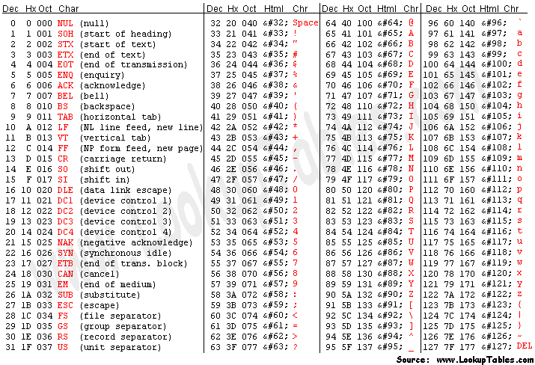
ASCII Table

Slide 4
Character Arrays
A piece of text enclosed in double quotes is called a string. Strings are stored as character arrays.
Defining a character array:
char arrayName[numElements];
The number of elements must be a constant or constant expression
Storage cells are contiguous
Immediately after all stored characters, store the terminating character '\0'
'\0' is the character whose ASCII code is 0
Accessing elements:
arrayName[index]
The index can be a constant, variable, or expression
Indices start at 0
The index must not go out of bounds

Slide 5


Initialisation
Brace initialisation (as with 1D arrays; the rest is set to '\0'):
char a[6]={'a','b','c','d','e','f'};
char b[10]={'a','b','c','d','e','f'};
String initialisation (a quoted string ends with '\0', taking one extra slot):
char a[10] = "abcdef";
char b[6] = "abcdef";
No room left for '\0', so it fails to compile

Slide 6
Two Ways to Read a Character Array from Console
Method 1: cin>>s;
  Stops at whitespace (' ', '\t', '\n', '\r')
  Used to read strings not containing whitespace
  The characters read do not include whitespaces
Both methods guarantee that right after the last character
read, the next position is set to '\0'
Method 2: fgets(s,m,stdin);
  Used to read a whole line that may contain whitespaces
  s: char array, m: expected character count, stdin: standard input
  Reading stops in two cases:
    If input length k ≥ m-1: reads m-1 chars (subscript 0 – m-2); s[m-1] is '\0'
    If input length k < m-1: stops at newline ('\n'), reads k chars (indices 0–k-1); s[k] is '\n', s[k+1] is '\0'
  To read m chars: array size m+2 (better m+10); 2nd argument m+1 (better m+5)
  Use strtok(s,"\r\n"); to strip the \r\n
// Example: read 100 chars
// (incl. whitespace)
char s[110];
fgets(s, 105, stdin);
strtok(s, "\r\n");

Slide 7
strlen: Number of Characters (String Length)
strlen(s) function:
Starting from index 0, it moves forward, stops at '\0', and returns the number of characters before the '\0'
Note
If the char array contains no '\0', the value returned by strlen(s) is unpredictable.
char b[10] = "abcdef";
cout << strlen(b); // prints 6
char a[6] = {'a','b','c','d','e','f’};
cout << strlen(a);
Unpredictable – wrong usage
char b[10] = {'a','b','c','d','e','f’};
cout << strlen(b); // prints 6

Slide 8
Printing Strings
Method 1: use cout to print it all at once
  Prints from index 0 up to '\0'
char s[110] = "abcd efgh";
cout << s; // Output: abcd efgh
Method 2: traverse the char array and print each character one by one
char s[110] = "abcd efgh";
int len = strlen(s);
for(int i=0; i<len; ++i)
cout << s[i];
While traversing, you can add any processing, e.g. a dot between every two characters:
char s[110] = "abcd efgh";
int len = strlen(s);
cout << s[0];
for(int i=1; i<len; ++i)
cout << '. ' << s[i];

Slide 9
Example-Swap Letter Case
Problem
Read a string of up to 1000 letters/digits; swap the case of each letter, keep digits, print it.
char s[1010];
cin >> s;
int len = strlen(s);
for(int i=0; i<len; ++i){
if('a'<=s[i] && s[i]<='z')
s[i] = s[i]-'a'+'A';
else if('A'<=s[i] && s[i]<='Z')
s[i] = s[i]-'A'+'a';
}
cout << s;
Analysis
Length ≤ 1000; allowing for '\0', use size 1010
No whitespace, so read with cin
Count characters with strlen()
Valid characters: subscript 0 to len-1
Loop over each character:
  Lowercase → uppercase
  Uppercase → lowercase
  Otherwise unchanged
What if you remove this else
? Why?

Slide 10
Example-Check for a Palindrome
Problem
A palindrome reads the same both ways. Read a string; print YES if it is a palindrome, otherwise NO.
No whitespace; length ≤ 100.
char s[110];
cin >> s;
int len = strlen(s), i, j;
for(i=0,j=len-1; i<=j; ++i,--j)
if(s[i] !=s [j])
break;
if(i > j)
cout << "YES";
else
cout << "NO";
char s[110];
cin >> s;
int len = strlen(s), i, j;
for(i=0,j=len-1; i<=j; ++i,--j)
if(s[i] !=s [j]){
cout << "NO";
return;
}
cout << "YES";
Analysis
Length ≤ 100; allowing for '\0', use size 110
No whitespace, so read with cin
Count characters with strlen()
Compare the 1st with the last, the 2nd with the 2nd-last, and so on
Two indices: one counts up from 0, one down from len-1, until they cross

Slide 11
strcmp(): Compare Two Strings
strcmp(s1,s2) function:
Compares two strings s1 and s2; there are 3 possible results:
s1 < s2: returns a negative number (usually -1, but not guaranteed to be -1)
s1 = s2: returns 0
s1 > s2: returns a positive number (usually 1, but not guaranteed to be 1)
Compares character by character from left to right (by ASCII value) until a different character or '\0' is reached.
If all characters are equal, s1 equals s2;
At the first differing character, if the s1[i]'s ASCII value is less than that of s2[i], then s1 < s2; otherwise s1 > s2.
If one string ends before the other and all characters up to that point are equal, the one that ends first is smaller (essentially, '\0' is smaller than every other character).
char s1[110] = "abcdef";
char s2[110] = "abcdef";
cout << strcmp(s1,s2); //Output: 0
char s1[110] = "abcdef";
char s2[110] = "abcdeg";
cout << strcmp(s1,s2); // Output:-1
char s1[110] = "abcdef";
char s2[110] = "abcdee";
cout << strcmp(s1,s2); //Output: 1
char s1[110] = "abc";
char s2[110] = "abcd";
cout << strcmp(s1,s2); //Output: -1
char s1[110] = "abcd";
char s2[110] = "abc";
cout << strcmp(s1,s2); //Output: 1
char s1[110] = "abbd";
char s2[110] = "abc";
cout << strcmp(s1,s2); //Output: -1

Slide 12
strcpy(): Copy a String
strcpy(dst,src) function:
Copies the contents of string src into dst: character by character from left to right until '\0' ('\0' is copied too).
[Note]
strcpy only works on character arrays, not on arrays of other types.
int a[110], b[110] = {1,2,3,4,5};
strcpy(a, b); //compile error
char s1[110], s2[110] = "abcdef";
strcpy(s1, s2);
cout << s1; //Output: abcdef
To copy any kind of array, use the memcpy(dst, src, size) function:
Copies all of src into dst, element by element from index 0 (each element of src to the same index in dst).
size is the size of array src, always written as sizeof(src).
[Note]
If src is longer than dst can hold, it goes out of range.
char s1[5], s2[110] = "abcdef";
strcpy(s1, s2); // out of range
int a[110], b[110] = {1,2,3,4,5};
memcpy(a, b, sizeof(b)); //copy all of b into a
strcpy returns the dst array, so you can operate directly on its return value
char s1[110], s2[110]="abcdef";
cout << strlen(strcpy(s1,s2)); //Output: 6

Slide 13


strcat(): Concatenate Strings
strcat(dst, src) function:
Appends the contents of char array src to the end of dst, then adds '\0' at the end.
[Note]
If src is longer than the space left in dst, it goes out of range.
char s1[10] = “abcd”, s2[10] = "efg";
cout << strlen(s1) << " " << strlen(s2) << endl; // Output: 4 3
strcat(s1, s2);
cout << strlen(s1) << " " << s1; //Output: 7 abcdefg
char s1[10] = "abcdefg", s2[10] = "hij";
strcat(s1, s2);
s1 has 3 free places, s2 has 3 characters to copy,
plus a final ‘\0’, so the array subscript goes out of range
s1 before:
s1 after:
strcat returns the dst array, so you can operate directly on its return value
char s1[10] = “abcd”, s2[10] = "efg";
cout << strlen(strcat(s1, s2)); //Output: 7

Slide 14
Thank You
Note: Please turn off your microphone and camera
Mr. Gao's Coding Camp

